Slide 1
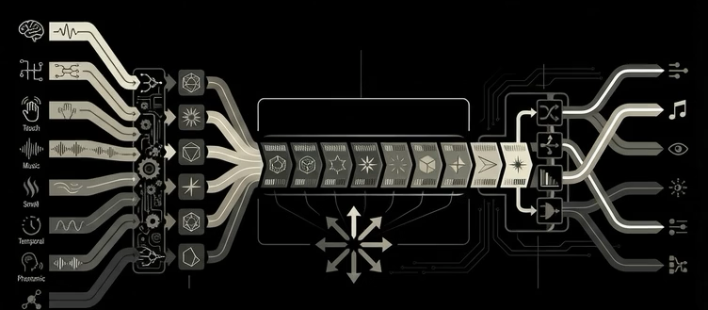

8 Geometric Primitives
text
emojis
ZPE-IMC
diagrams
images
voice
music
taste
smell
mental
touch

